Slide 1
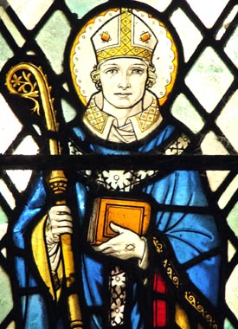
The St. Piran Deanery Synod Meeting
Oversight and Local Ministry
22nd March 2024

Slide 2
The Inherited Expectation…
Illustration from a 2019 consultation document: Towards a generous and flourishing Diocese of Sheffield in 2025

Slide 3
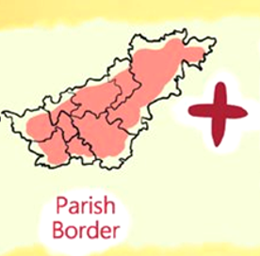
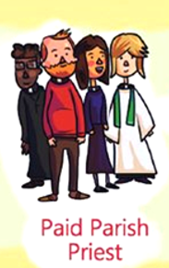
Our Reality…

Slide 4
Our Reality...

Slide 5
Our Reality...

Slide 6
Our Reality...

Slide 7
Our Reality...

Slide 8
Our Reality...

Slide 9
Our Reality...

Slide 10
Our Reality...

Slide 11
Our Reality...

Slide 12
Our Reality...

Slide 13
Our Reality...

Slide 15
12 Deanery Plans for a fruitful and sustainable future.

Slide 16
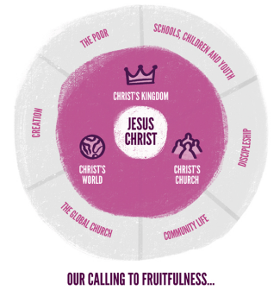

Slide 17
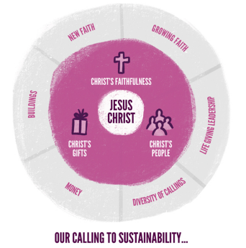

Slide 18
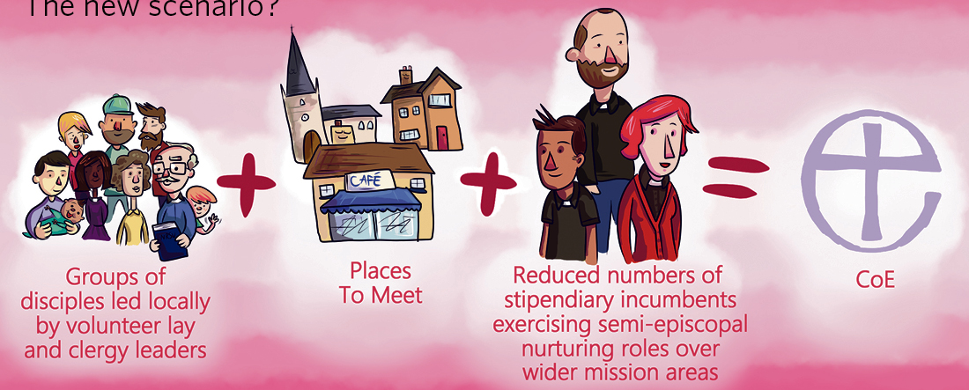
On The Way...
Illustration from a 2019 consultation document: Towards a generous and flourishing Diocese of Sheffield in 2025

Slide 19
Oversight Minister
Local Minister
Vicar/
Rector
Lay Minister
Pioneer Minister
Chaplain
Operations Manager

Slide 32
Lay Training...
Sens Kernewek is a community of women and men exploring a call to local church leadership.
It is designed to be a group in which people learn together and discern together.

Slide 33
What sort of church is God calling you to be...
Oversight Ministry
Sustainable
Fruitful

Slide 34
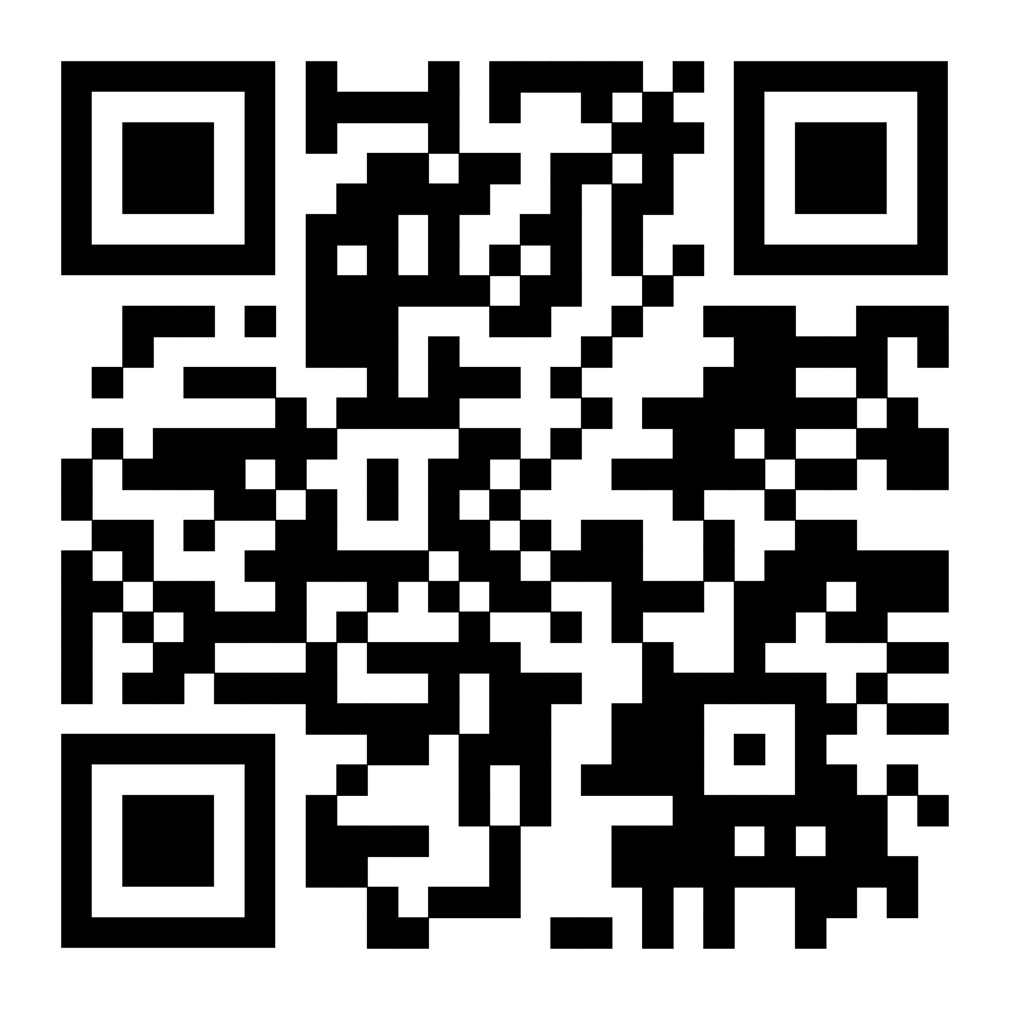
Your PCC’s and Congregations
Use this PowerPoint in small groups or at your PCC’s.
Watch the Video at home, in small groups or in your PCC’s.
Use this accompanying Booklet either with the Video or PowerPoint.
You can download all three here:
https://tinyurl.com/3b6tut8h
(Or contact me for paper copies.)
Zoom calls or in-person visits can also be arranged.

Slide 35
Let us Pray...
Faithful God, as you led your people of old,
into a new and fruitful place,
so lead us too today we pray.
Show us the way to go,
and help us on the way with the courage and the faith
and the imagination that we need,
that we may be the church that you truly called us to be.
We ask this in the name of Jesus Christ our Lord.
Amen.

